Slide 1
CHAPTER 2: An Introduction to Systems Concepts and Systems Architecture
The Architecture of Computer Hardware, Systems Software & Networking: An Information Technology Approach
5th Edition, Irv Englander
John Wiley and Sons ©2013
PowerPoint slides authored by Angela Clark, University of South Alabama
PowerPoint slides for the 4th edition were authored by Wilson Wong, Bentley University

Slide 2
What is a system?
What do the following systems have in common?
Plumbing system
Solar system
Home network system
Inventory control system

Slide 3
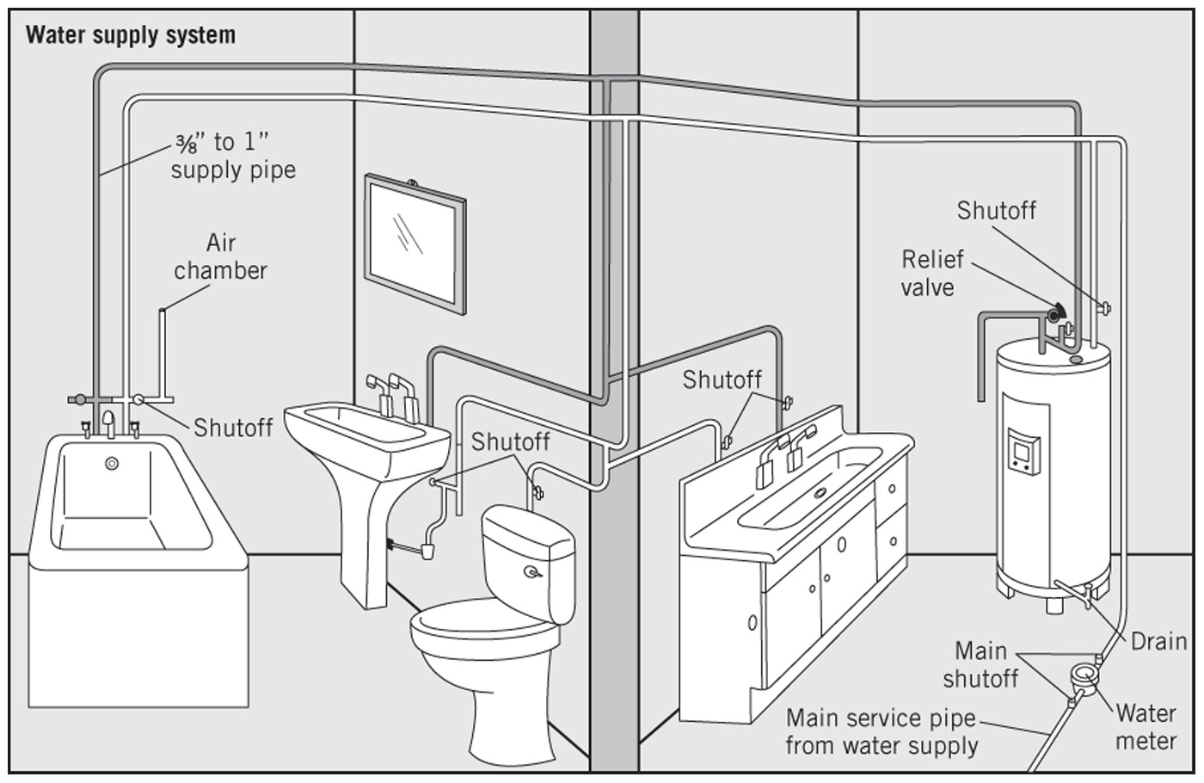
Plumbing System

Slide 4
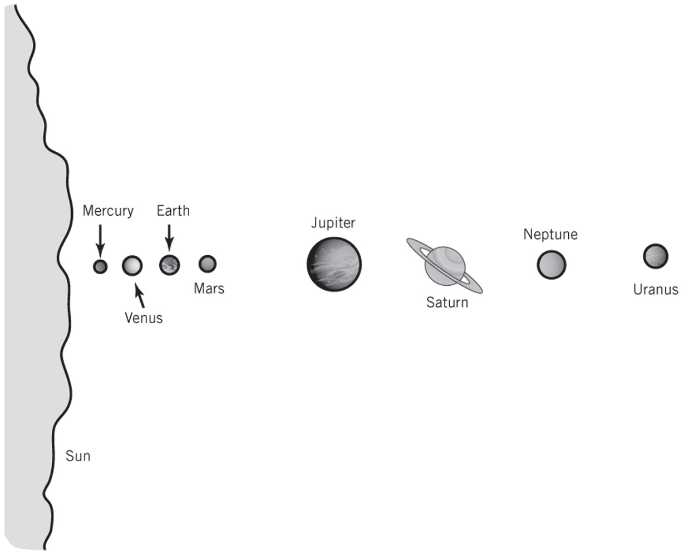
Solar System

Slide 5
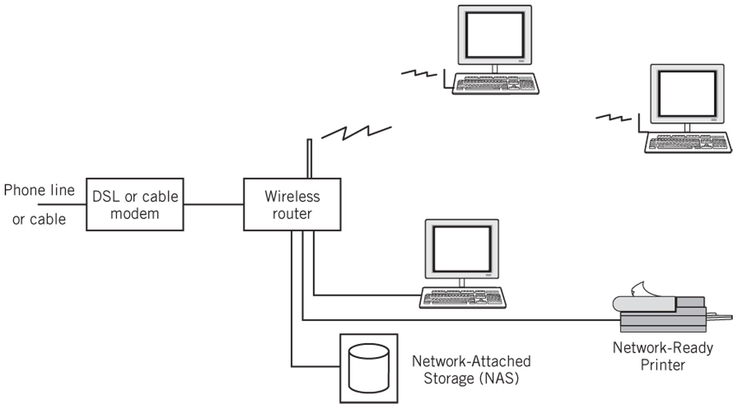
Home Network System

Slide 6
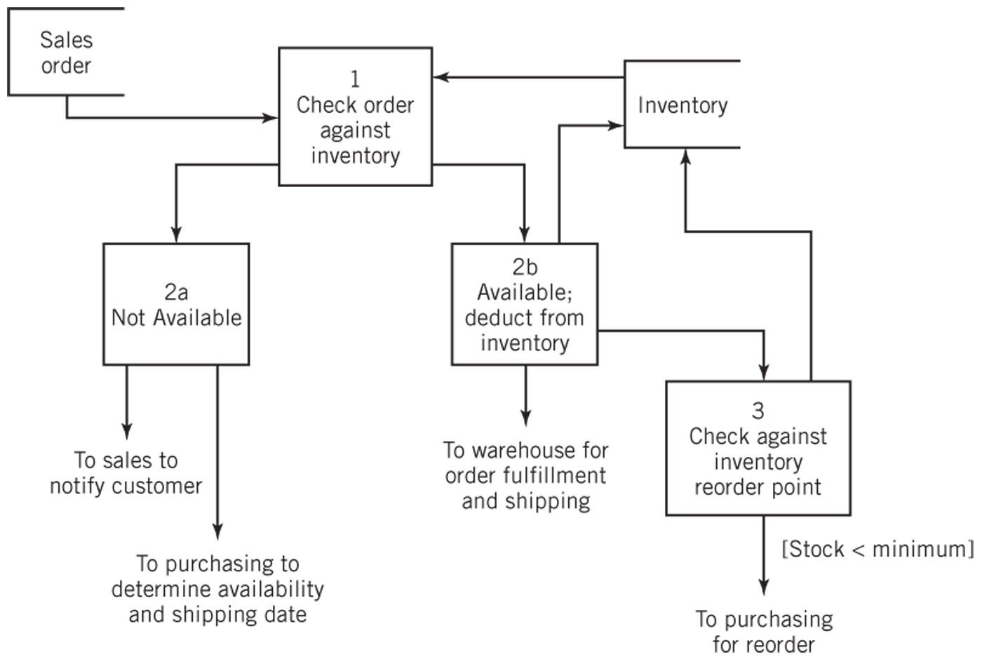
Inventory Control System

Slide 7
Definition of a System
“A system is a collection of components linked together and organized in such a way as to be recognizable as a single unit.”
Linked components of a system also define a boundary for the system
The environment is anything outside of the system

Slide 8
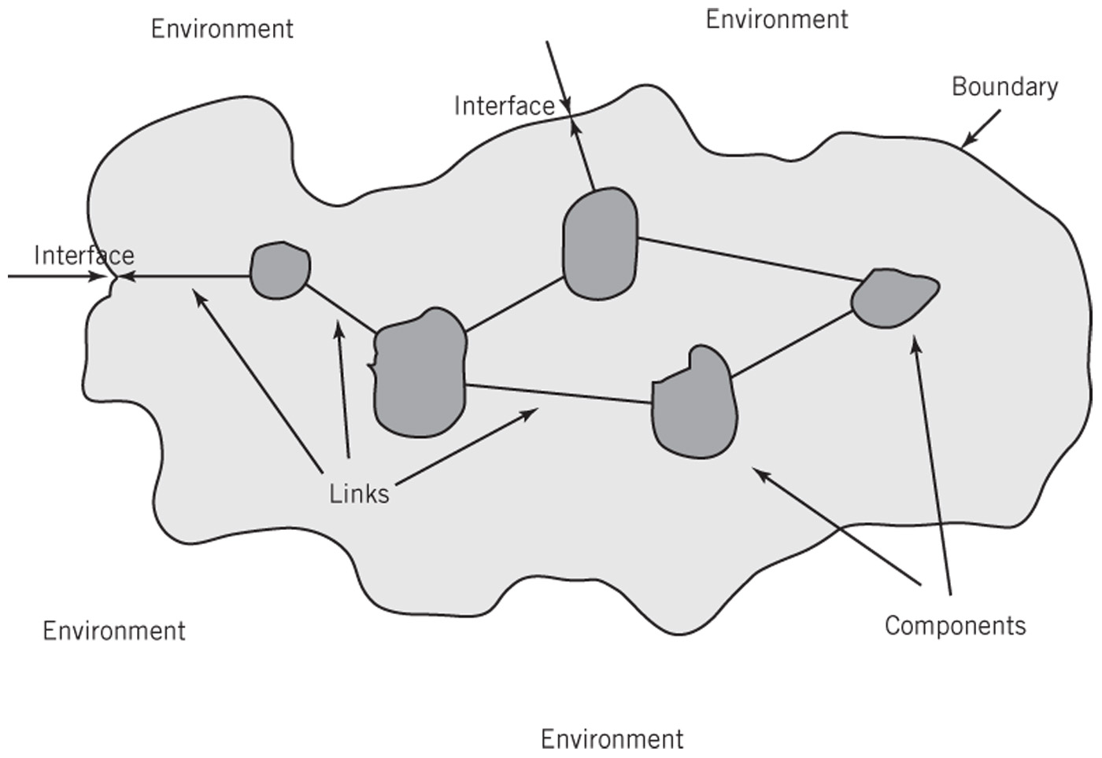
General Representation of a System

Slide 9
System Decomposition
Components
May be irreducible or
May be subsystems
Decomposition
The division of a system into its components and linkages
Hierarchical

Slide 10
System Architecture
“The fundamental properties, and the patterns of relationships, connections, constraints, and linkages among the components and between the system and its environment are known collectively as the architecture of the system”

Slide 11
Abstractions of Systems
How are the following two abstractions of a business system different from one another?
How are these abstractions different from the real business system?

Slide 12
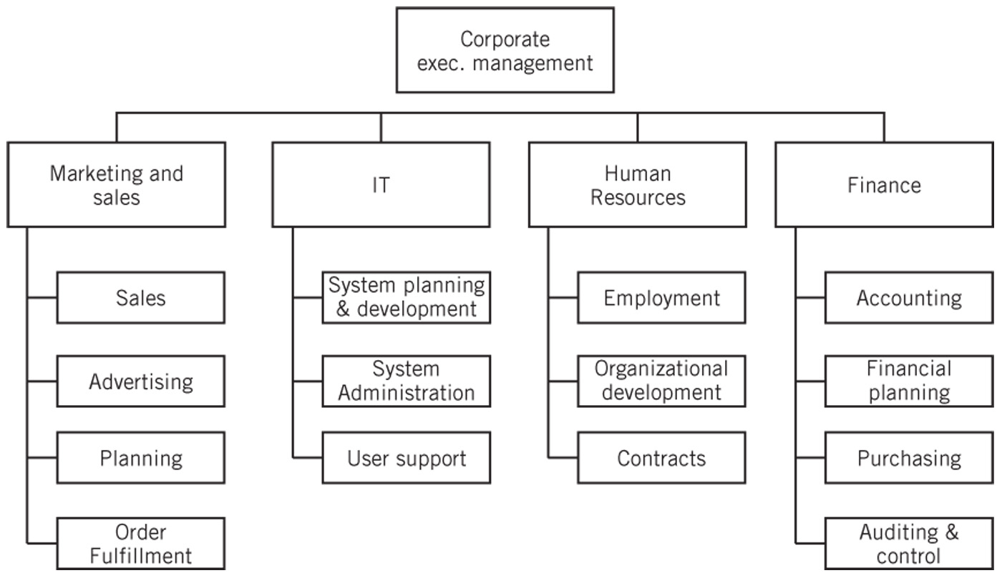
Business Organization Chart

Slide 13
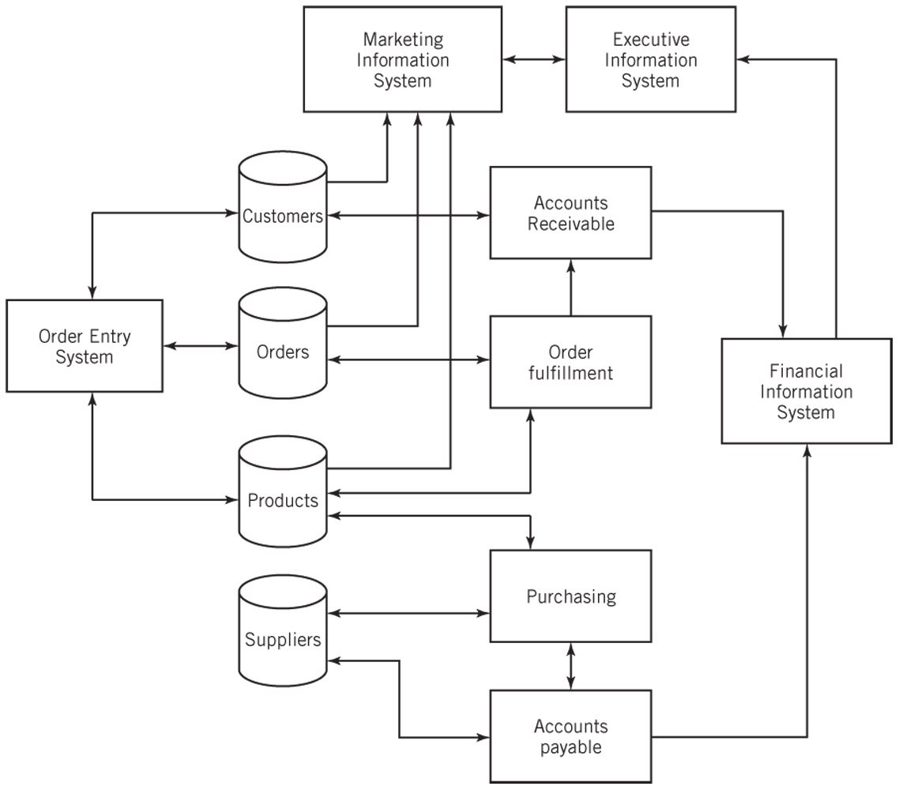
Business Application Architecture

Slide 14
IT System Architectures
Distributed processing systems
Client-Server Computing
Two-tier architecture
Three-tier architecture
N-tier architecture
Web-Based Computing
Cloud Computing
Peer-to-Peer Computing

Slide 15
Client-Server Computing
A program on a client computer requests services from a program on a server computer
Examples:
Email services, file services, print services, directory services, Web services, database services, application services, remote access services

Slide 16
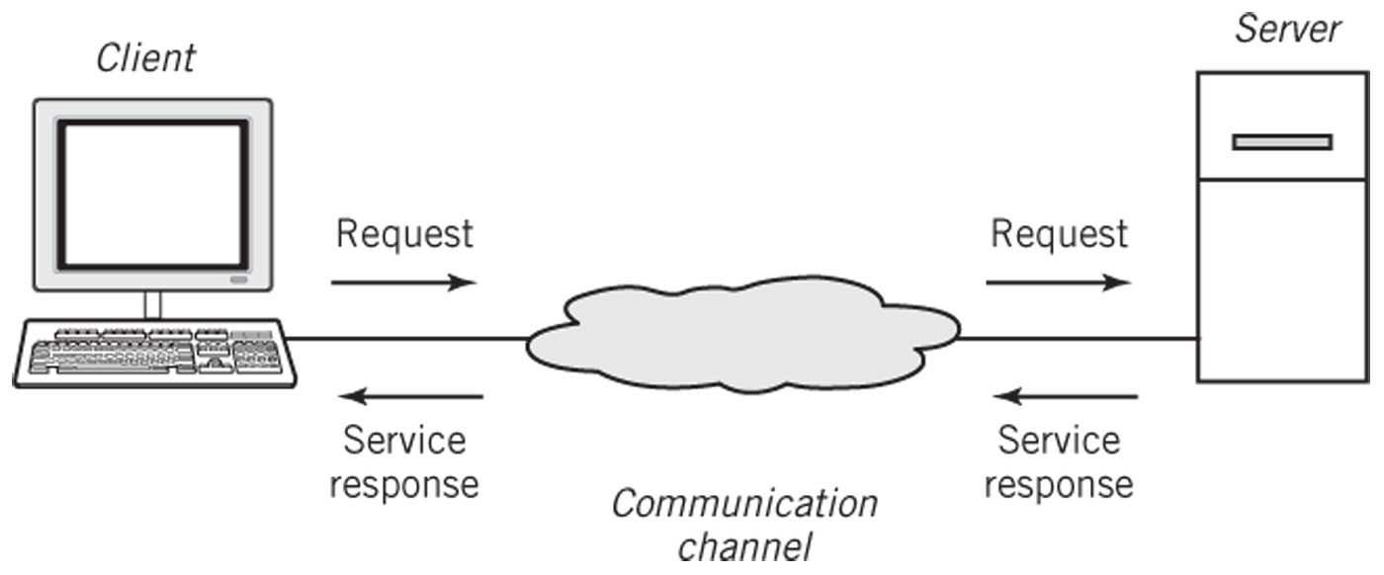
Basic Client-Server Architecture

Slide 17
Advantages of Client-Server Architecture
Centralization of services permits
easier administration of services by IT professionals
easier availability and location by users
consistency of resources, such as files and data, can be managed and assured
more efficient and cost-effective hardware procurement through purchasing a small number of very powerful computers

Slide 18
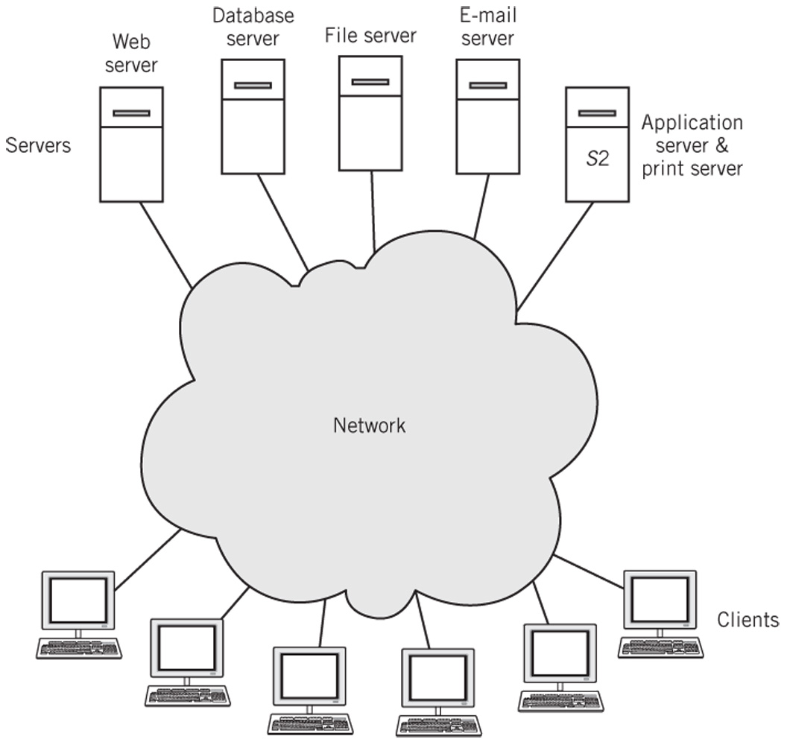
Clients and Servers on a Network

Slide 19
Multi-tier Architectures
Two-tier architecture
Two computers are involved in a service
Example: Web browser and Web server model used in intranets and on the Internet
Three-tier architecture
Three computers are involved in a service
Example: client computer, Web server, database server
N-tier architecture

Slide 20
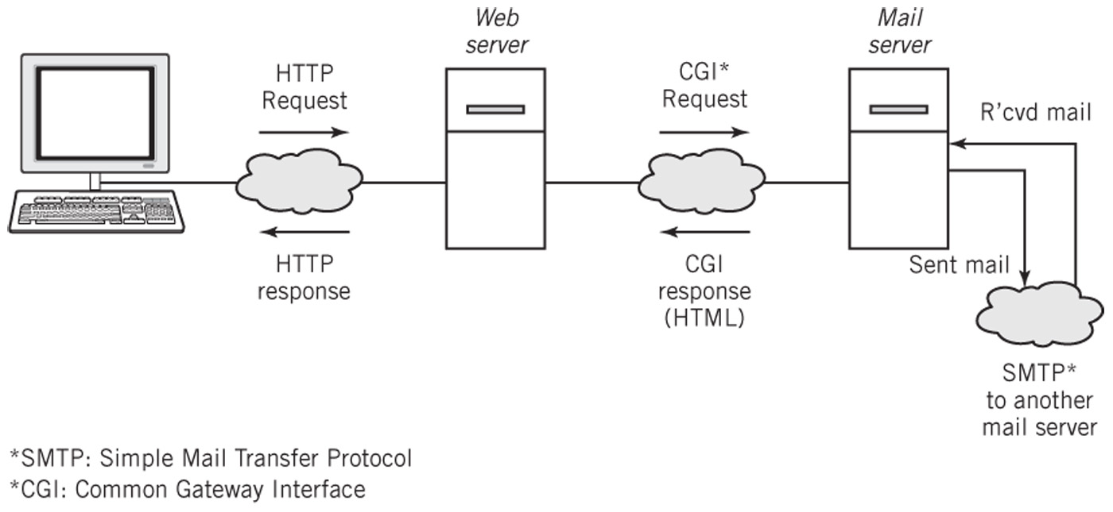
Three-tier Web-based Email Architecture

Slide 21
Cloud Computing
Off-site storage facilities for an organization
Software as a service (SaaS): applications run on a server or processing may be divided on server and client
Platform as a service (PaaS): tools for a developer to create and run applications on a cloud platform
Infrastructure as a service (IaaS) – cloud-based hardware emulation of virtual machines and networking

Slide 22
Cloud Computing Advantages/Risks
Advantages
Client’s datacenter needs are simplified; reduced costs
Supports collaboration
Scalable to a variety of host platforms
Reduced maintenance downtime
Lower investment for short-term projects
Risks
Quality of security is critical
Outages or loss of connectivity may prevent users from working
Requires long-term commitment and viability of cloud service
Changes in operating procedures can result in data loss

Slide 23
Peer-to-Peer Computing
Computers on a network are treated as equals
Each computer can share resources with the other computers on the network
Disadvantages
Difficult to establish centralized control of services
Difficult to locate services
Difficult to synchronize versions of files or software
Difficult to secure network from unauthorized access and from viruses
Advantages
Sharing files between personal computers
Internet file sharing

Slide 24
Hybrid Model of Computing
Client-server technology used to locate systems and files
Then systems can participate in peer-to-peer transactions
Examples
Instant messaging
Skype
Napster

Slide 25
Google: System Architecture
Provide powerful, fast search capability for material on the Internet
Derive income from advertising that is targeted to each user based on their searches
Basic requirements
Capable of responding to millions of simultaneous requests from all over the world
Perform a web crawl of the Internet to retrieve and organize data
Establish ranking of results with appropriately targeted advertising
High reliability of the system
System is easily scalable and cost effective

Slide 26
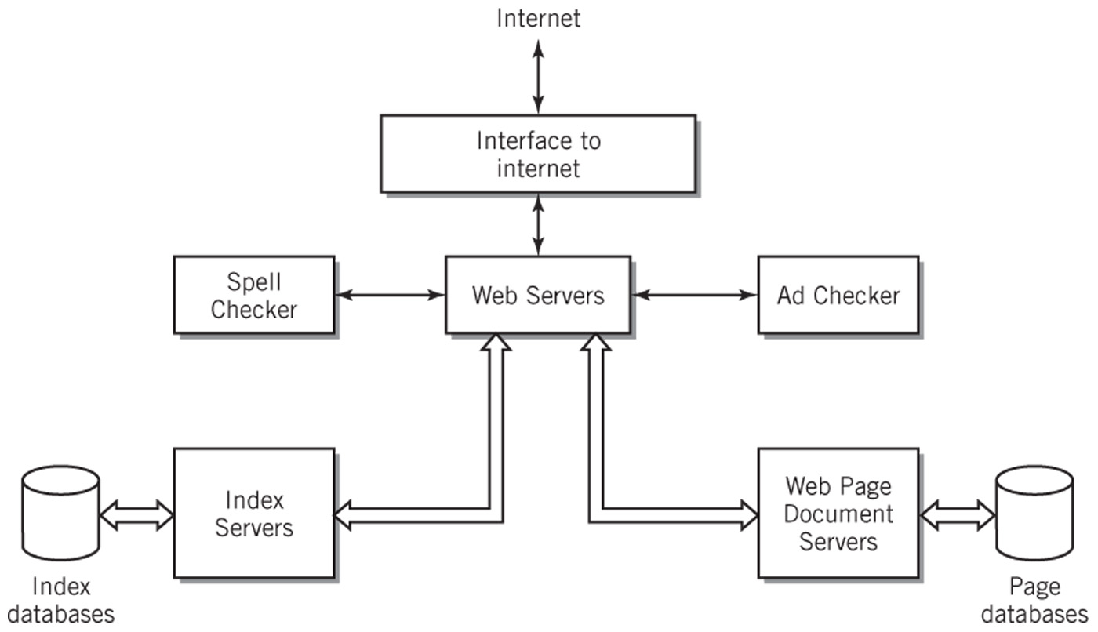
Google Data Center Search Application Architecture

Slide 27
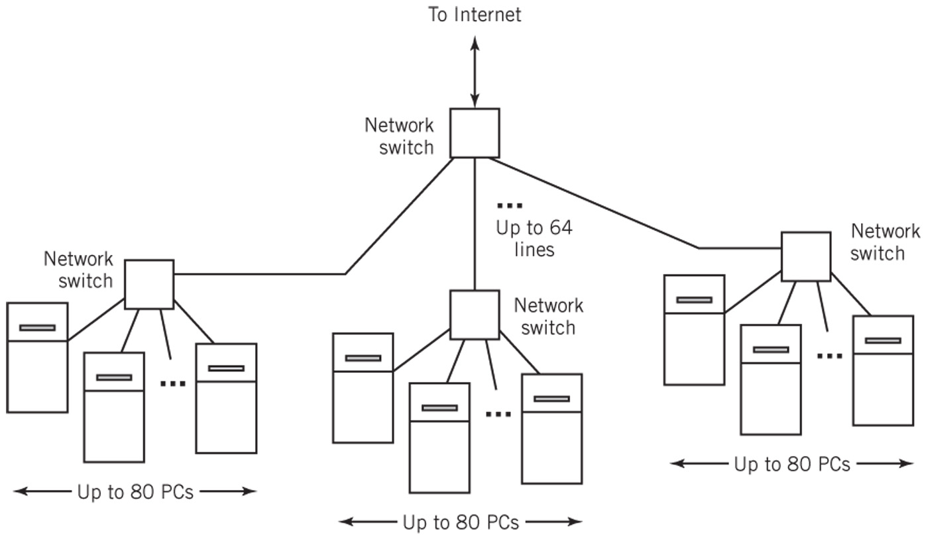
Simplified Google System Hardware Architecture

Slide 28
Facebook’s Application Architecture
N-tier architecture
Based entirely on open source software
Serves as an intermediary between web browser and an application provider’s Web service
API and protocols allow information exchange between Facebook servers and the application server

Slide 29
Copyright 2013 John Wiley & Sons
All rights reserved. Reproduction or translation of this work beyond that permitted in section 117 of the 1976 United States Copyright Act without express permission of the copyright owner is unlawful. Request for further information should be addressed to the Permissions Department, John Wiley & Sons, Inc. The purchaser may make back-up copies for his/her own use only and not for distribution or resale. The Publisher assumes no responsibility for errors, omissions, or damages caused by the use of these programs or from the use of the information contained herein.”

